Slide 1
jQuery
CS4032 Web Programming

Slide 2
Quiz from JavaScript on Monday 4/4/22

Slide 3
jQuery
A JavaScript library that makes DOM manipulation easier and more consistent

Slide 4
jQuery is a library of JavaScript functions
Helps minimize the amount of JavaScript you
have to write in order to:
Access DOM elements
Modify the appearance of a web page
Provide sophisticated animation effects
Alter the content of a document
Retrieve information from a web server without refreshing the page (using Ajax)
Hides DOM differences between browsers
Allows you to write browser-independent JavaScript!
This was a big deal a few years ago when DOM differences between browsers existed.

Slide 5
jQuery
jQuery is open source
Note: multiple versions are available:
jquery-x.y.z.min.js – release version
“minified” (whitespace removed) - smaller, more compact
Takes less time to load your web page
jquery-x.y.z.js – development version
NO NEED TO DOWNLOAD; just include the url to a CDN in your .html files:
<script src="https://code.jquery.com/jquery-3.4.1.min.js"
integrity="sha256-CSXorXvZcTkaix6Yvo6HppcZGetbYMGWSFlBw8HfCJo=" crossorigin="anonymous"></script>

Slide 6
Include the jQuery library before your JavaScript code
<!DOCTYPE html>
<html>
<head>
<title>Your title</title>
<!-- Include jQuery, then your own .js files or code -->
<script src="https://code.jquery.com/jquery-3.4.1.min.js"
integrity="sha256-CSXorXvZcTkaix6Yvo6HppcZGetbYMGWSFlBw8HfCJo=" crossorigin="anonymous"></script>
<script src="myJavascript.js"></script>
</head>
<body>
<!-- Your html goes here -->
</body>
</html>
Note: The version of jQuery shown here is 3.4.1; Make sure you use the latest version. See www.jquery.com for the latest release url

Slide 7
jQuery philosophy/design approach is simple
Focus on the interaction between JavaScript and HTML (Almost) every operation boils down to:
Find DOM element
(e.g. paragraph, id, class…)
Do something to it
(color it, move it, change it…)

Slide 8
jQuery’s consistent syntax
Basic syntax is: $(selector).action()
A $ sign to define/access jQuery
A (selector) to "query (or find)" HTML elements
A jQuery action() to be performed on the element(s)

Slide 9
jQuery vs JS
JavaScript
jQuery
let el = document.getElementById(“hello”);
el.innerHTML = “hello world”;
Or
document.getElementById(“ hello”). innerHTML=“hello world”;
$(“#hello”).html(“hello world”);
No error even if element not found

Slide 10
What’s that $ about ??
Almost everything starts with a call to the jQuery() selector function.
Since it’s called so often, the $ global variable is defined as an alias to the function: var $ = jQuery; //shortcut to jQuery function
Thus you could write either:
$(“#p2”).html(“hello world”);
Or
jQuery(“#p2”).html(“hello world”);

Slide 11
$( selector )
selector can be one of the following:
A CSS selector expression
A string of HTML
A JavaScript object

Slide 12
jQuery CSS selector
$(“#goButton”) // ~getElementById(“goButton”)
$(“.index”) // ~getElementsByClassName(“index”)
$(“p” ) // ~getElementsByTagName(“p”)
$(“p.abc em”) // gets ALL <em>’s in <p>’s of class abc
$(“p, h1”) // gets ALL <p> and <h1> elements
$(“:button”) // gets ALL <input>’s of type “button”
$(“:contains(‘hi’)”)// all elements containing text “hi”
$(“p:contains(‘hi’)”)// all <p> elements containing “hi”

Slide 13
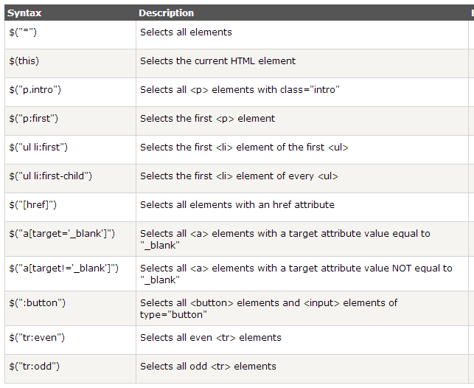
More examples of jQuery Selectors

Slide 14
$(selector).<action>()
An <action>() method typically follows the jQuery selector, specifying what operation to perform on the selected element(s)
Examples:
$(“p”).hide(); // hides ALL p’s (implied iteration)
$(“#p1”).fadeOut(); // fades element with id of #p1
$(“.xyz”).css({“color”:”blue”}); // changes CSS on all elements of class “xyz” (implied iteration)

Slide 15
Implied Iteration
A selector such as $(“p”) that select more than one element automatically invokes the action for each element:
// Hide ALL <p> elements on the page
$(“p”).hide();
// Change the color on ALL elements of class “xyz”
$(“.xyz”).css({“color”:”blue”});
// Change font size on ALL <input> button elements
$(“:button”).css({“font-size”:”36px”});
// hide all <input> button elements of class “xyz”
$(“.xyz:button”).hide();

Slide 16
Hiding and showing elements
$(“h1”).hide(); // immediately hides ALL h1
$(“#p1”).hide(“slow”); // slowly hides #p1
$(“.xyz”).hide(“fast”);
$(“p”).hide(5000); // user-specified rate
$(“h1:first”).show(); // immediately show FIRST h1
$(“h1:first”).toggle(); // show or hide

Slide 17
Sliding: another way of hiding and showing elements
$(“h1”).slideUp(); // hide at a default rate
$(“#p1”).slideUp(“slow”);
$(“.xyz”).slideUp(“fast”);
$(“p”).slideUp(5000);
$(“h1:first”).slideDown(); // show
$(“h1:first”).slideToggle(); // show or hide
hide(), show() with no arguments change the visibility immediately – no animation is provided
slideUp() and slideDown() even with no arguments provide default animation

Slide 18
Fading elements in and out
$(“h1”).fadeOut();// h1 fades at default rate (400ms)
$(“#p1”).fadeOut(“slow”); // slowly fades out
$(“p”).fadeOut(5000); // user-specified fade rate
$(“h1:first”).fadeIn(); // fadesIn at default rate
hide(), show(), and toggle() work by shrinking and expanding the height of the selected element(s)
fadeIn() and fadeOut() operate by varying the opacity of the selected element(s)

Slide 19
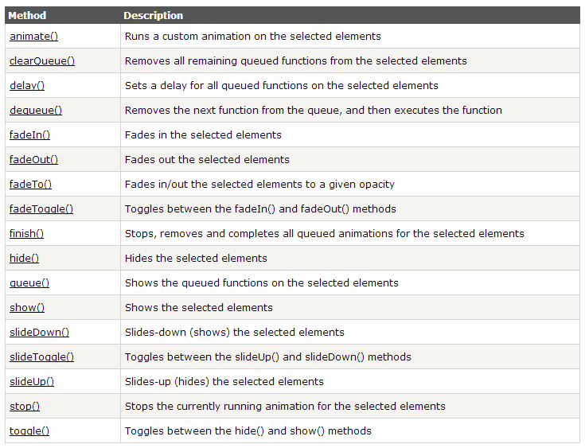
jQuery Effect Methods Reference: http://www.w3schools.com/jquery/jquery_ref_effects.asp

Slide 20
Method chaining
$(“h1”).fadeOut().fadeIn();
fadeIn() executes after fadeOut() completes.
fadeOut() and fadeIn() are placed in jQuery’s animation queue, which processes actions in sequence.
Note: This is similar to using Java’s invokeLater() method to execute operations in sequence on the Event Dispatch Thread

Slide 21
Iteration filters let you specify exactly which elements in a selector are affected:
// Hide only the first <p> element on the page
$(“p:first”).hide();
// Hide only the last <p> element on the page
$(“p:last”).hide();
// Hide the 2nd <p> element on the page
// Note: 0-based indexing
$(“p:eq(1)”).hide();
// Change the color on all elements of class “.xyz”
$(“.xyz”).css({“color”:”blue”});
// Change the color only on the even rows of a table
$(“tr:even”).css({“color”:”blue”});
See http://api.jquery.com/category/selectors/

Slide 22
Iterating through multiple elements
<par id=“p1>This is paragraph 1.</p>
<par id=“p2>This is paragraph 2.</p>
In jQuery:
$(“p”).each( function(index) {
// the index is automatically incremented by
// jQuery with each iteration
if( index == 0 ) {
// code for 1st <p> goes here…
}
// $(this) is the current jQuery object in the iteration
if( $(this).text().indexOf(“2”) !== -1 ) { //contains “2”?
// code for 2nd <p> goes here…
}
if( $(this).is(“#p2”) ) { // is current element #p2?
…
} }

Slide 23
$(this) vs. this
$(this) is a jQuery object
You call jQuery methods on it
$(this).html(“hello”);
this is the underlying DOM object
You call DOM methods on it
this.innerHTML = “hello”;
$(this)[0] == this;
$(“#p2”)[0] == document.getElementById(“p2);

Slide 24
Event Handling

Slide 25
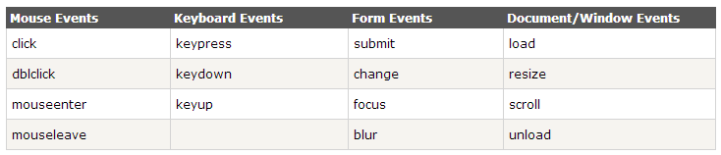
jQuery Event Methods
User actions that a web page can respond to are called events:
moving a mouse over an element
selecting a radio button
clicking on an element

Slide 26
window.onload
JavaScript
jQuery
window.onload = init;
// or window.document.body.onload=init; function init() {
// init code here…
}
$(window).load(init); or $(document).ready(init);//preferred!
$().ready( function() {…});

Slide 27
$(document).ready vs $(window).load
$(window).load executes after your pages loads, including any images your page may display.
Browsers load images on separate threads, since image loading can take a long time.
$(document).ready executes as soon as the browser completes DOM creation, which occurs (typically) before all of the images are loaded.
Your jQuery script can thus start executing more quickly after a user browses to your page.
USE $(document).ready!!!

Slide 28
Handling events from input elements
JavaScript
jQuery
<input id=“okButton” type=“button” value=“OK” />
var button = document.getElementById(“okButton”); button.onclick = function() {
// button code here…
}
<input id=“okButton” type=“button” value=“OK” />
$(“#okButton”).click( function() {
// button code here… }

Slide 29
Example
$(“p”) – select all <p> elements on a page:
<script>
$().ready(function(){
$("button").click(function(){
$("p").hide(); // hides all <p> elements on button press
});
});
</script>
</head>
<body>
<h2>This is a heading</h2>
<p>This is a paragraph.</p>
<p>This is another paragraph.</p>
<button>Click me</button>
</body>
</html>

Slide 30
Example
<script>
$(document).ready(function(){ // ready event
$("button").click(function(){ // click event
$("p").hide(); });
$("#p1").mouseenter(function(){// mouse enter event alert("You entered p1!"); });
$("#p1").mouseup(function(){// mouse up event alert("Mouse up over p1!"); });
$("#p1").hover(function(){// hover event alert("You entered p1!"); }, function(){ alert("You left p1!"); });
});
</script>
Useful events:
click()
dblclick()
mouseenter()
mouseleave()
mousedown()
mouseup()
hover()

Slide 31
Handling events from multiple elements
<input id=“okButton” type=“button” value=“OK” />
<input id=“quitButton” type=“button” value=“OK” />
$(“:button”).click( function() { // handle ALL button clicks
if( $(this).is(“#okButton”) { // $(this) is current element
// code for handling okButton goes here…
}
if( $(this).is(“#quitButton”) {
// code for handling quitButton goes here…
} }

Slide 32
Callbacks

Slide 33
Callback functions can be supplied to execute after the action takes place
function doIt() {alert(“hid it!”);}
// doIt executes after each hide() completes
$(“h1”).hide(doIt);
$(“#p1”).hide(“slow”, doIt);
// Anonymous function executes after
// show() completes
$(“.xyz”).show(“fast”, function(){alert(“made it visible!”);} );

Slide 34
Custom animations

Slide 35
jQuery can automatically handle animations of elements
Note: Elements to be animated have to be positioned either fixed, absolute, or relative.
Static elements cannot be animated!
Format of the animate method:
$(“#p2”).animate({left:”100px”},500);

Slide 36
Stopping an animation or effect before it is finished
Syntax:
$(selector).stop([clearQueue],[jumpToEnd]);
Immediately stops the currently-running animation.
clearQueue – if false, the next animation in the chain begins; if true, all subsequent animations are cancelled.
jumpToEnd – if true, the end result of the animation being stopped is applied
Example with chaining:
$("#p1").slideUp(2000).slideDown(2000);
If the slideUp animation is executing when stop(false, false) is called, the slideUp animation stops immediately, and the slideDown animation begins executing.

Slide 37
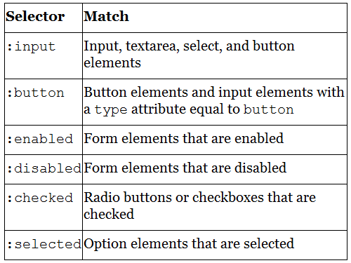
Form Selectors

Slide 38
To select an input by type:
To select a text input (selects all if >1)
$('input:text');
To get the textbox value
$('input:text').val(); // alternate: $(“#t1).val()
To set the textbox value
$('input:text').val("New Text");
<input id = “t1” type="text" value="This is some text">

Slide 39
Button selection by button type
To select a submit button
$('input:submit');
To select a reset button
$('input:reset');
To select a checked radio button
$("input[type='radio']:checked");

Slide 40
Additional References
jQuery Base
http://api.jquery.com/category/core/?rdfrom=http%3A%2F%2Fdocs.jquery.com%2Fmw%2Findex.php%3Ftitle%3DCore%26redirect%3Dno
jQuery Selectors
http://api.jquery.com/category/selectors/?rdfrom=http%3A%2F%2Fdocs.jquery.com%2Fmw%2Findex.php%3Ftitle%3DSelectors%26redirect%3Dno
jQuery Events
http://api.jquery.com/category/events/?rdfrom=http%3A%2F%2Fdocs.jquery.com%2Fmw%2Findex.php%3Ftitle%3DEvents%26redirect%3Dno
Many examples of using selectors: http://docs.jquery.com/DOM/Traversing/Selectors

